Slide 1

Chest Disease X-Ray Image
Deep Learning CNN
Presented by:
Abdullatif Alsabr Eman Albarakah
Yazeed Alharthi Rahaf Alturbaq
Aljoharah Alaqeel

Slide 2
Outline
01.
02.
03.
Introduction
About Project
Challenges
04.
05.
06.
Models
Tools
Conclusion

Slide 3
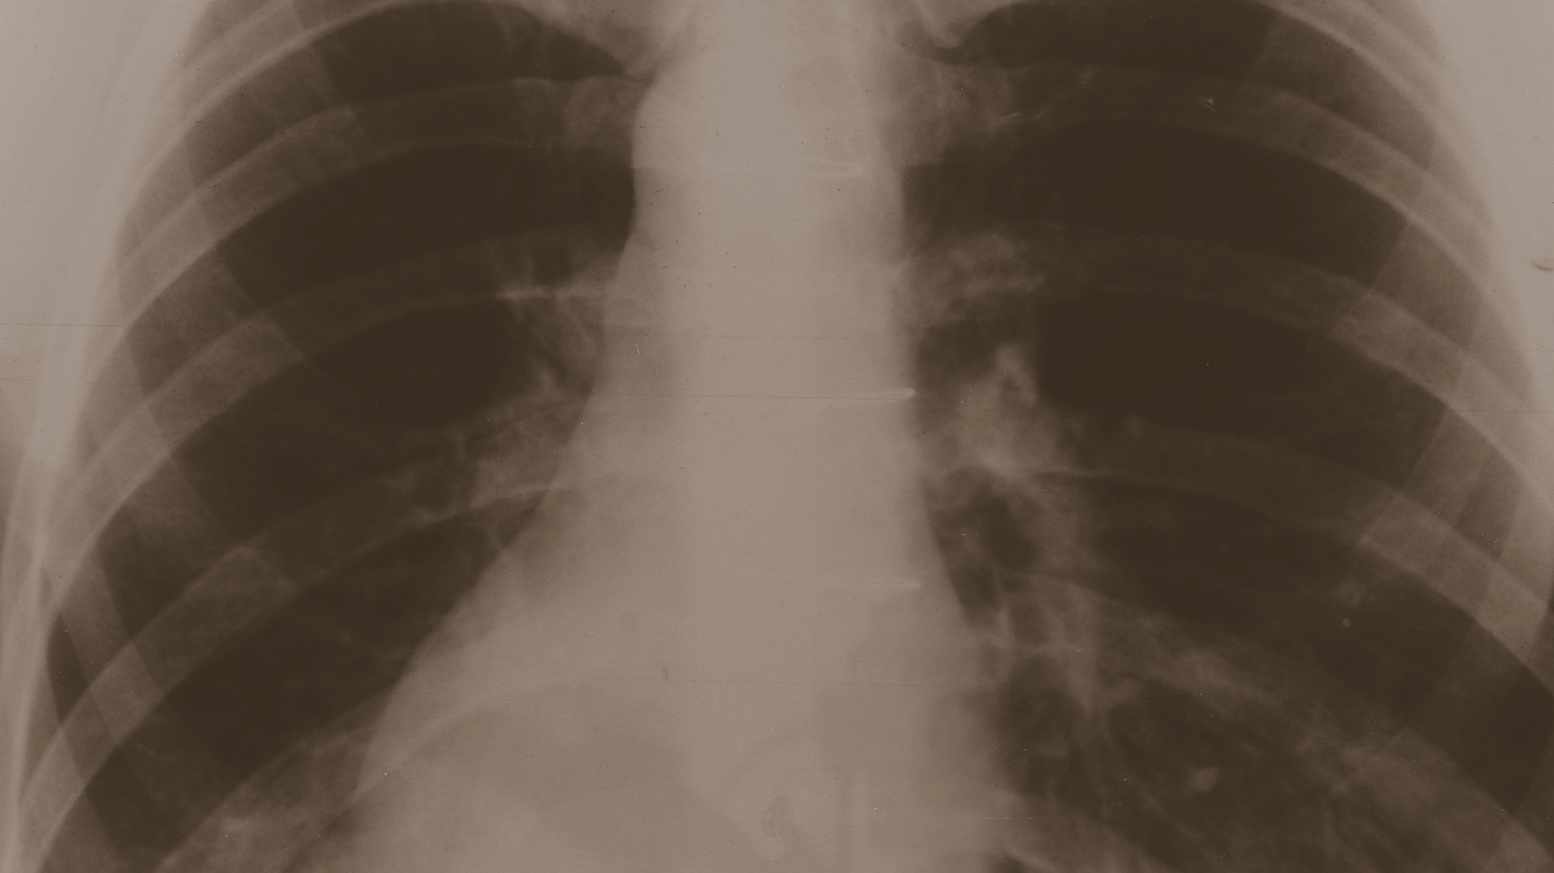
Introduction
Pneumonia is an inflammatory condition of the lung affecting primarily the small air sacs known as alveoli.
Symptoms typically include some combination of productive or dry cough, chest pain, fever and difficulty breathing. The severity of the condition is variable.
Pneumonia is usually caused by infection with viruses or bacteria and less commonly by other microorganisms, certain medications or conditions such as autoimmune diseases.
Risk factors include cystic fibrosis, chronic obstructive pulmonary disease (COPD), asthma, diabetes, heart failure, a history of smoking, a poor ability to cough such as a stroke and a weak immune system.

Slide 4
About Project
The dataset is organized into 3 folders (train, test, val) and contains subfolders for each image category (Pneumonia/Normal).
There are 5,863 X-Ray images (JPEG) and 2 categories (Pneumonia/Normal).
Data from Kaggle.

Slide 5
Challenges
1. Excution time problems such:
Epoch 12 – 20 - 50.
Improve accuracy after Epoch.
Cannot execute all models at the same time unless using multiple files for each model.
2. Define number of hidden layers.
3. Hard to define and find best parameters for each model.

Slide 6
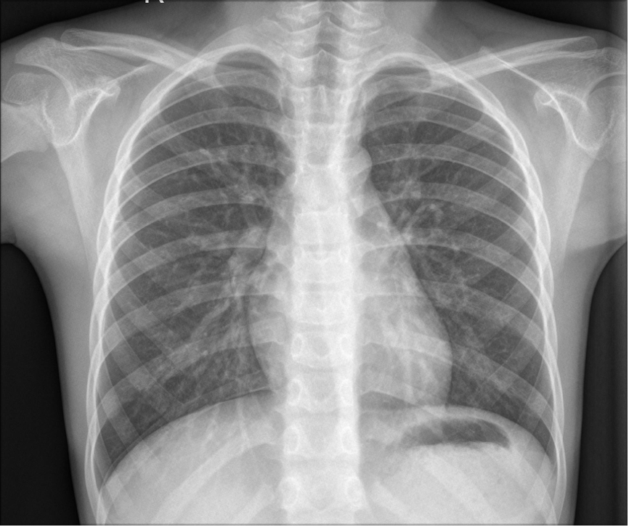
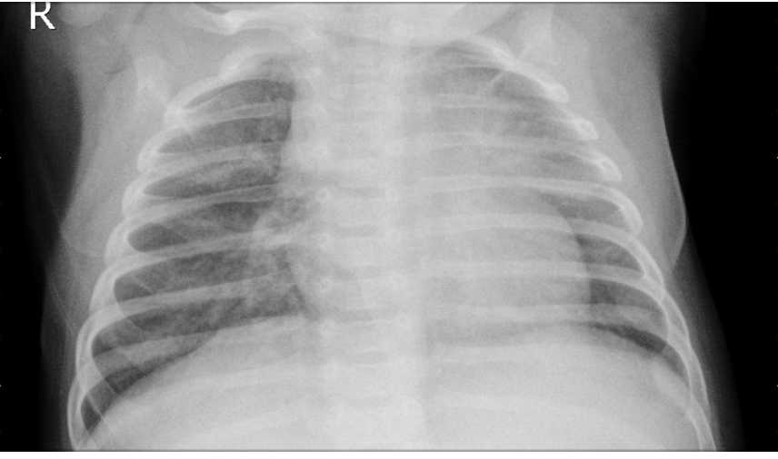
An Example of Normal and Infected by Pneumonia Lugs
Normal Lungs
Lungs infected by Pneumonia

Slide 7
Models

Slide 8
Preprocess
Reshapping
224 x 224
Normalization
1./255
Batch Size
10

Slide 9
1. Sequential
Optimizer | Early Stopping | Without Early Stopping
rmsprop | Epoch 20 | Epoch 12
 | Stopped at 3/20
Accuracy | 96 % | 95 %

Slide 10
2. VGG16
Optimizer | Early Stopping | Without Early Stopping
Adam | Epoch 20 | Epoch 20
 | Stopped at 3/20
Accuracy | 96 % | 98 %

Slide 11
3. VGG19
Optimizer | Early Stopping | Without Early Stopping
Adam | Epoch 50 | Epoch 12
 | Stopped at 6/50
Accuracy | 97 % | 98 %

Slide 12
4. MobileNetV2
Optimizer | Early Stopping | Without Early Stopping
Adam | Epoch 50 | Epoch 12
 | Stopped at 3/50
Accuracy | 96 % | 98 %

Slide 13
5. InceptionV3
Optimizer | Early Stopping | Without Early Stopping
Adam | Epoch 50 | Epoch 12
 | Stopped at 3/50
Accuracy | 94 % | 97 %

Slide 14
Models
Model | Accuracy
 | Train - Validation | Test
Sequnetial | 96% | 82%
VGG16 | 98% | 91.50%
VGG19 | 95% | 91.82%
MobileNetV2 | 95% | 91.82%
InceptionV3 | 95% | 87%

Slide 15
Conclusion
The test results showed that VGG19 and MobileNetV2 outperforms other models by accuracy of 91.82%.
Whereas Sequential model outperformed by accuracy of 96% and VGG16 outperformed other models by accuracy of 98% that showes us in train we’ve had a good results but not in test.
Future Work
Improve the classification accuracy of all the models.
Classify other lung diseases.
Create an application to detect all lung diseases.

Slide 16





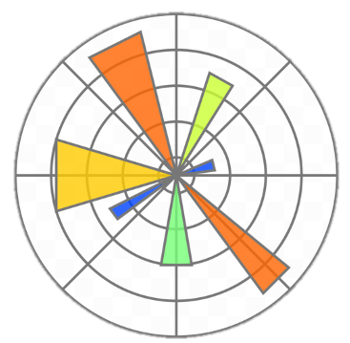


Tools
Here are the tools we used in this project

Slide 17
Thank you for your attention. Any questions?

